Slide 1
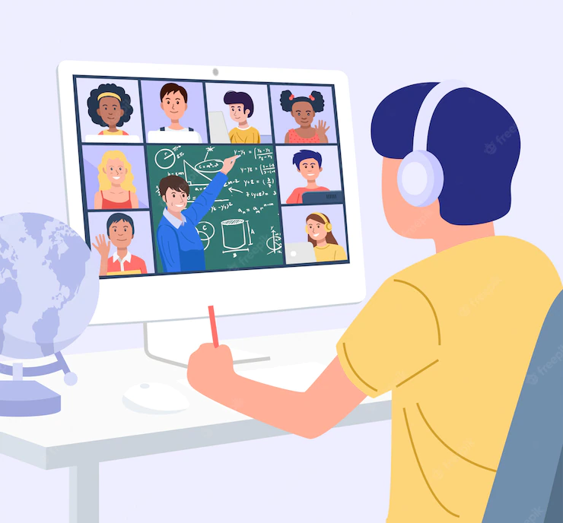
Zooper
Approach to better prototype

Slide 2

Team Members
Shreyashree Sarkar
Subhabrata Chakraborty
Souvik Roy
Sandharb N Kamble
Adrija Saha
Sayak Mondal

Slide 3
Problem Statement:
Design a solution to prevent & identify the intruders/miscreants who joins an Online Session to create nuisance or to perform unethical activities.

Slide 4
Frustrations among students, has affected their mental health as well, resulting in unwanted behaviors and activities which disturbs the decorum of the session/academic activities.
The links for academic sessions/webinars/CREs are shared by a few students to miscreants, who then login into the meeting/sessions using the same link by using IDs or names of other identified participants. After login into the meeting, miscreant/mischievous students create indiscipline, confusion and use foul abusive languages to disturb the whole meeting.

Slide 5

Our Objectives
Solutions needed to identify miscreants.
They should not be able to use IDs and Names of the identified Participants/Students
Blocking intruders made easier for the Host
Offensive messages are tracked and not displayed in the chat box.

Slide 6

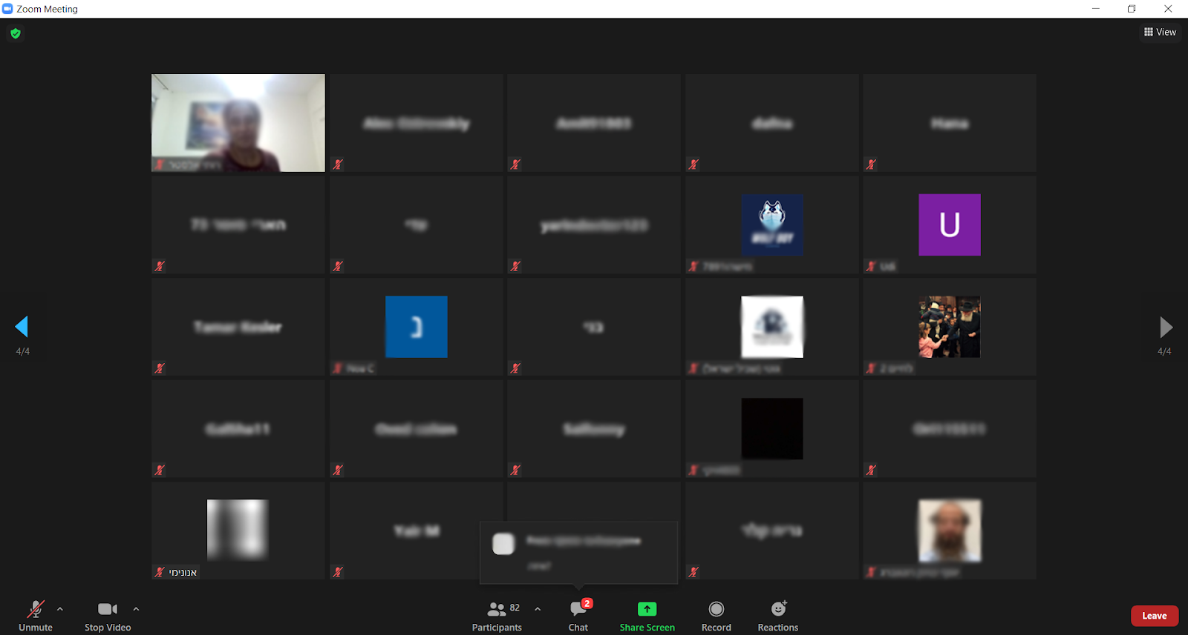
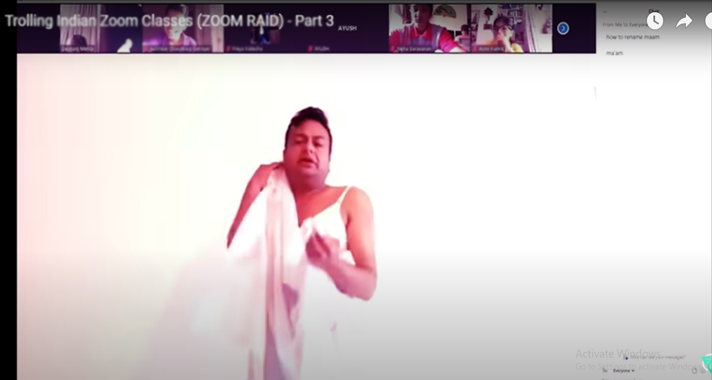
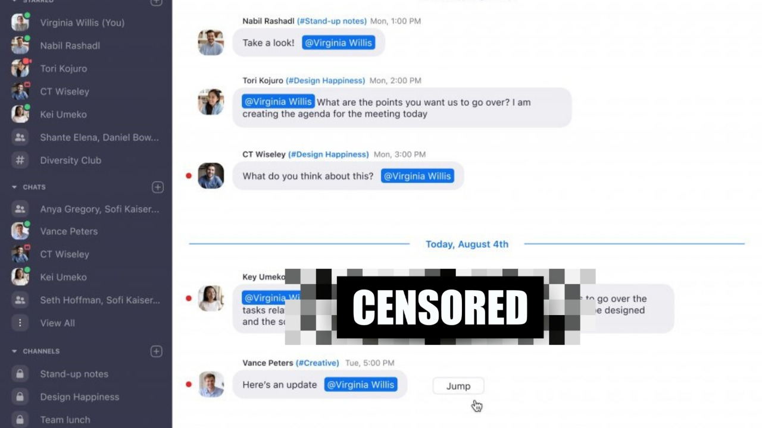
The Problem We Face(Shown by Screenshots)
Normal Class
Class disrupted by raiders
Inappropriate comments

Slide 7
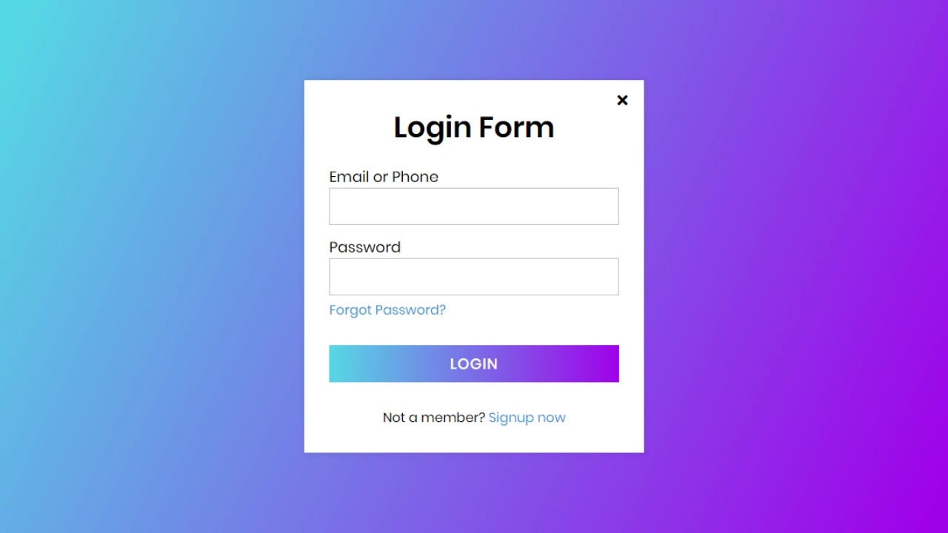
Our Solutions
Solutions needed to identify miscreants.
Credentials will be collected from individuals along with their face snap.

Slide 8
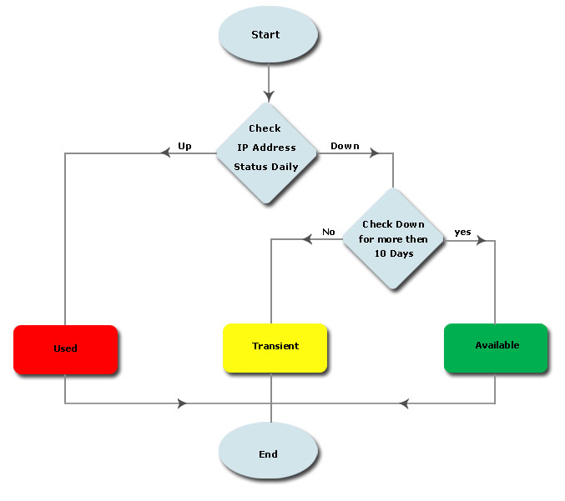
Our Solutions
Authorized Participants would be sign in to the portal, using Name, ID, Password and Face Snap.
The website will collect the IP from the device
The teacher will set time and dates and automatic links will be generated .
The students will join using the links after logging through the portal (Password & Camera)
For New device, verification code will be required

Slide 9
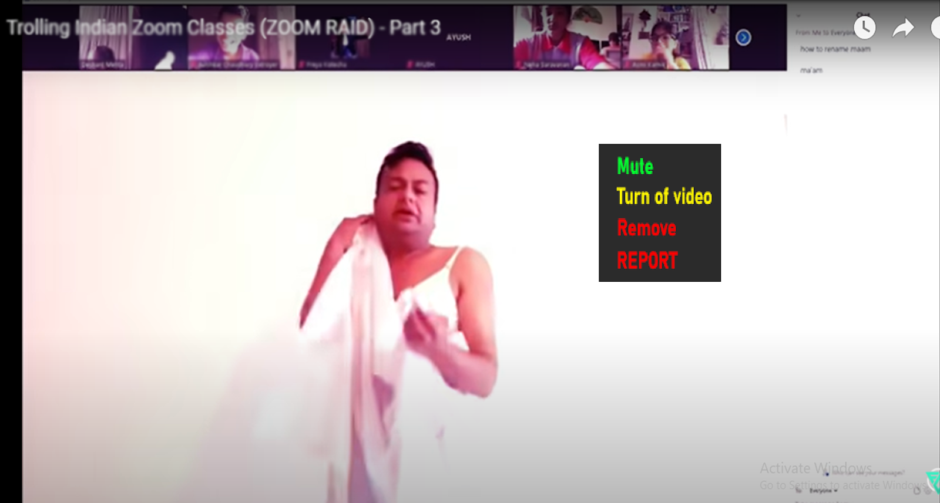
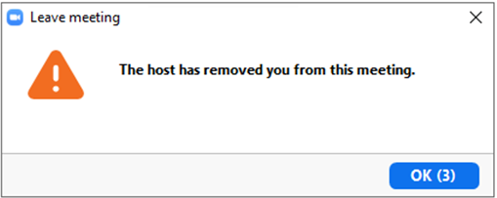
Blocking intruders made easier for the Host
If any mischievous activity is performed
The host will have the access to REPORT
If the IP is from the database then it will be shown

Slide 10
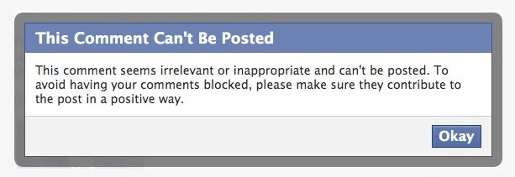
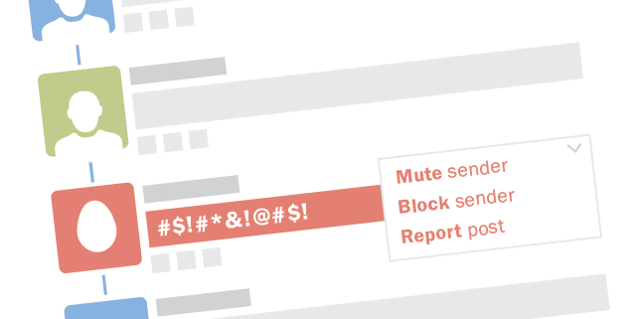
Our Solutions
Offensive messages are tracked and blocked
If someone sends vulgar messages, our “BOT” will censor that chat
A warning will be sent to the teacher

Slide 11
How the generated file looks like?
IP:- 172.67.23.02
Existing student IP or new:- New
Student name whose account got hacked:- Putin
Location:- 3.345377, 56.564833926
VPN:- no
Reported Time:- 12:10:16 IST

Slide 12
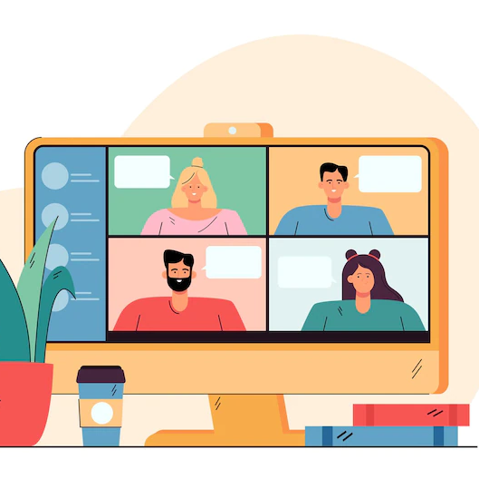
Thank you for your patience
Have a great day!

